Slide 1

Directory and File Handling Commands
Mina Gabriel

Slide 2
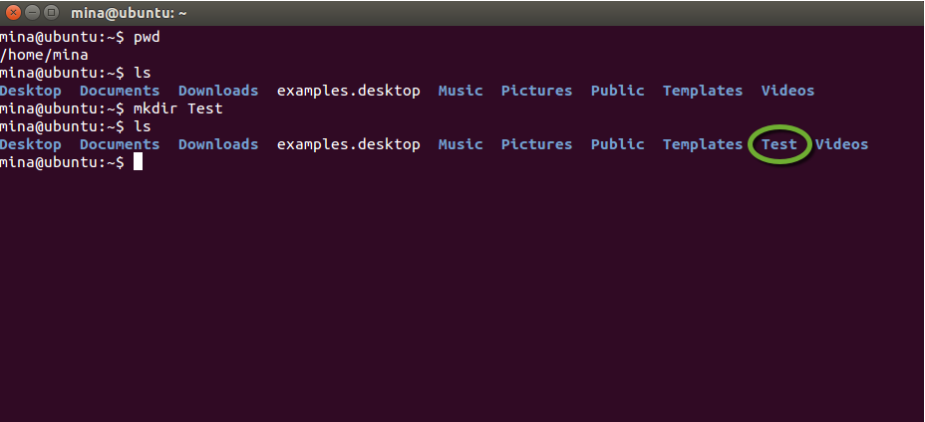
mkdir (make directory)
creates a subdirectory called Test in the current working directory. You can only create subdirectories in a directory if you have write permission on that directory.

Slide 3
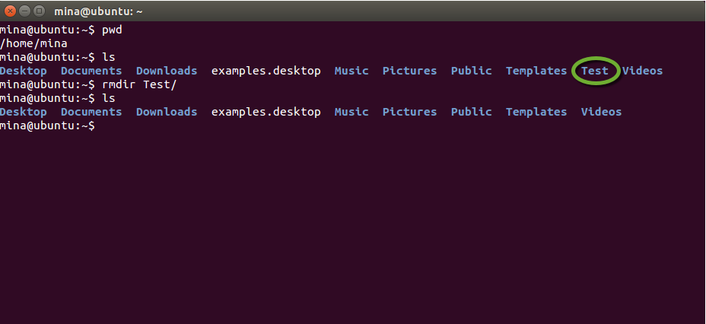
rmdir (remove empty directory)
removes the subdirectory Test from the current working directory. You can only remove subdirectories if they are completely empty (i.e. of all entries besides the '.' and '..' directories).

Slide 4
rm (remove files or directories)
In order to remove a directory using the rmdir command you will receive a prompt such as “directory not empty” and will be unable to delete the directory if it has files and sub directories
To remove a directory that contains other files or directories, use the following command.
-r remove directories and their contents recursively
rm -r “directory name”

Slide 5
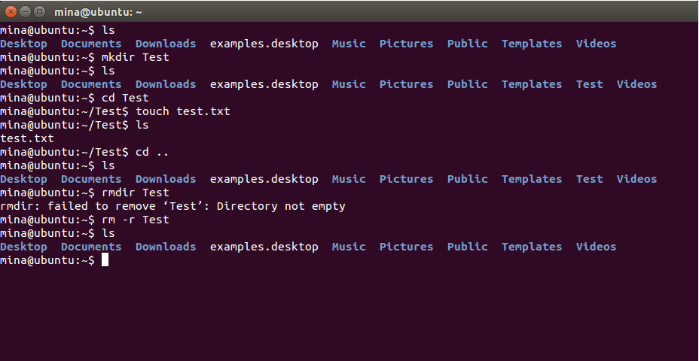
rm –r example

Slide 6
Exercise 1
We now know how to create directories in *nix:
go to Documents and make three directories :
CISC120
a directory for another class you are registered in.
and a third directory call it X, then
remove directory X.

Slide 7
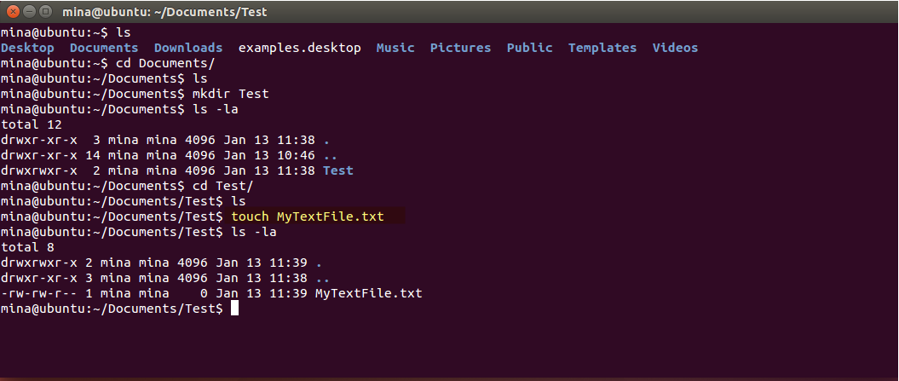
Create a file
One easy way to create an empty file is with
touch “file name and extension”

Slide 8
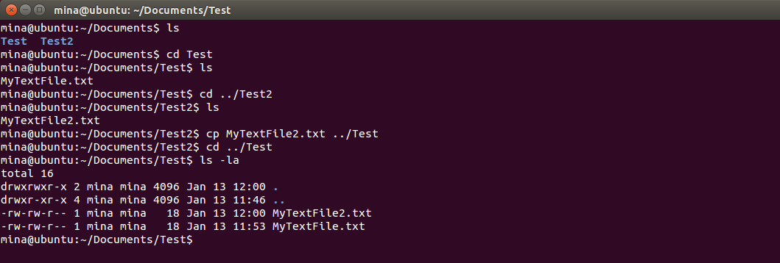
cp (Copy files )
cp is used to make copies of files or entire directories. To copy files, use:
The following screen will copy a text file from /Document/Test2/MyTextFile2.txt to /Document/Test
cp “source file” “destination directory”

Slide 9
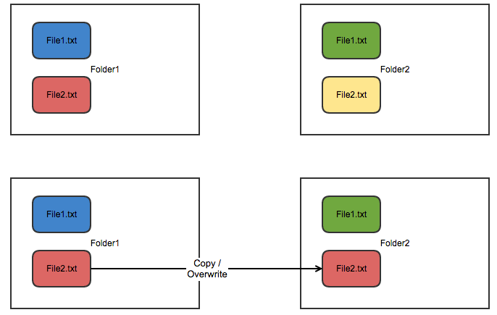
What happens when the file exists?

Slide 10
Exercise 2
inside ~/Documents/CISC120/ create a new text file, call it MyLinuxCommands.txt

Slide 11
Text editor vim vs nano …
Vim
vim isn’t known to be very user-friendly, and that’s immediately apparent by the fact that opening a file using a command such as vi starts a “Command mode” text editor.
This makes using vim as a first-time user extremely difficult as there’s no way of learning how to control vim except by going to read the documentation.

Slide 12

nano
nano has always been user-friendly when it comes to terminal text editors.
After opening your text file using the following command:
You will be able to see a recognizable user interface which displays the text contained within the file, along with various actions you can perform at the bottom. All of these actions are done in a CTRL +Key manner
nano “txt File”

Slide 13
nano
to open a file in nano editor you have to type nano key word followed by the file “location + name”
Notice: if you are trying to open a file that doesn’t exist inside the current working directory, nano will add this file for you.

Slide 14
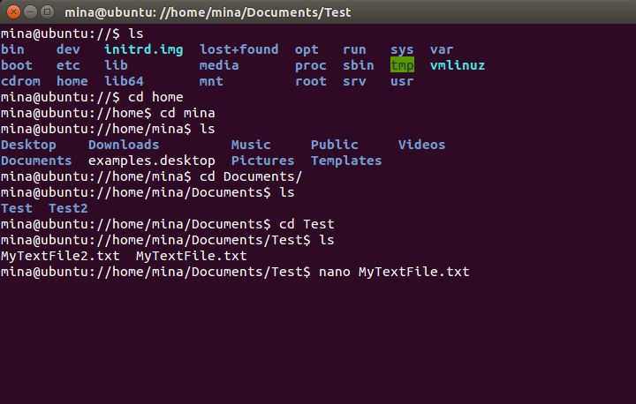
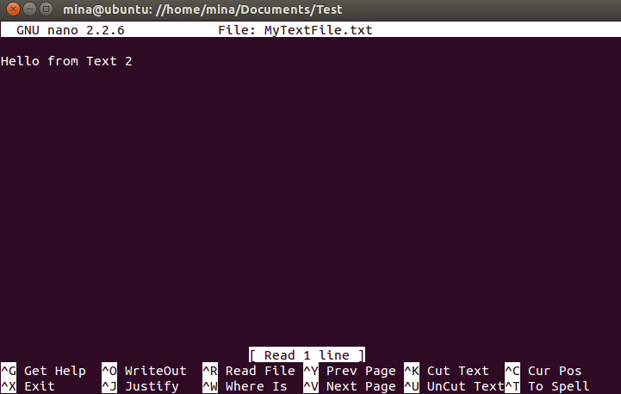
open a text file using nano
open an existing text file:

Slide 15
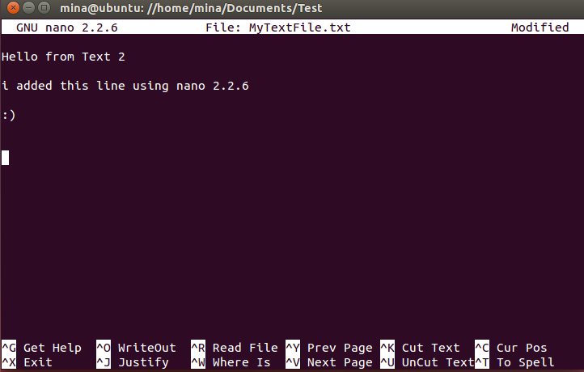
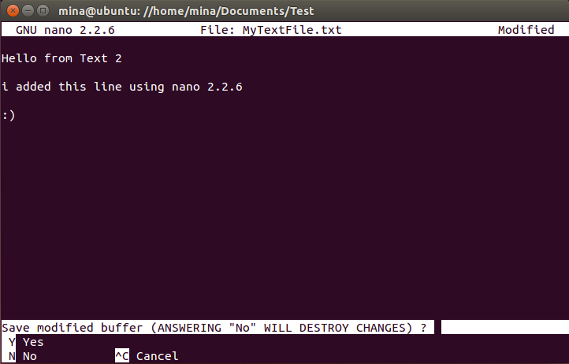
nano add text and exit
CTRL + X | save modified buffer y + return

Slide 16
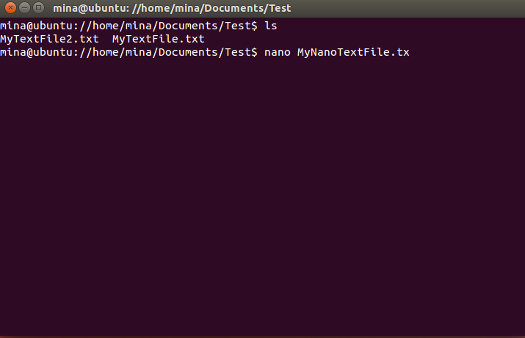
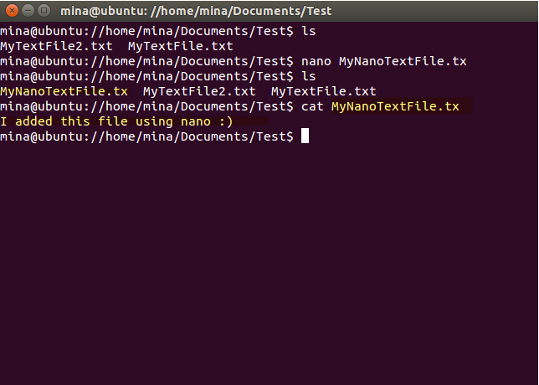
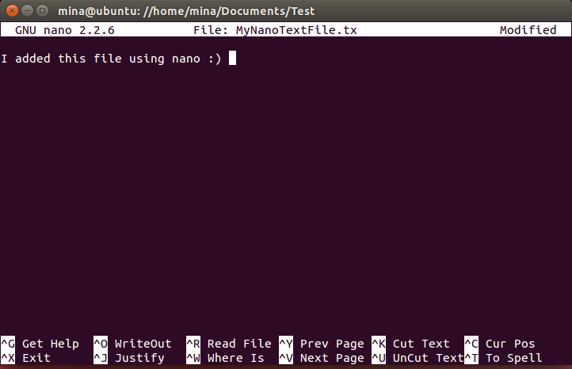
create a file using nano

Slide 17
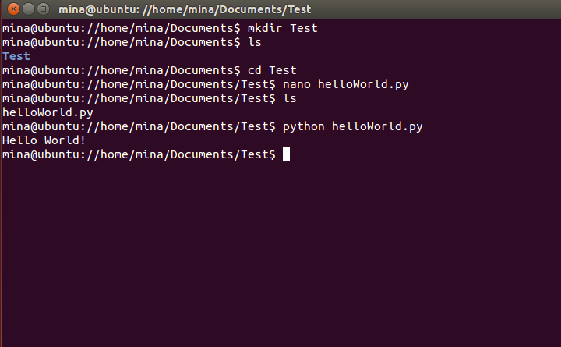
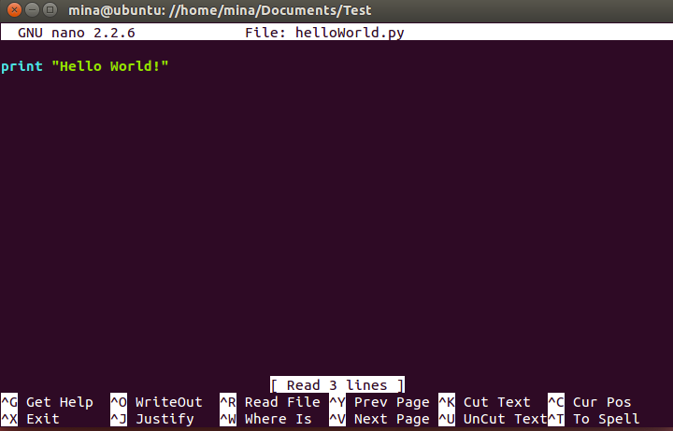
why do I need to know this?
you will use nano terminal text editor to create python files and execute them, example :

Slide 18
Exercise 3
open ~/Documents/CISC120/MyLinuxCommands.txt file using nano terminal text editor and some *nix commands and their descriptions

